Slide 1



Noida Institute of Engineering and Technology, Greater Noida
Object Oriented Techniques using Java
Unit: 2
Object Oriented
Techniques using
Java
Aditee Mattoo
A.P, IoT, SCSET
Course Details
(B Tech 3rd Sem /2nd Year)
Object Oriented Techniques using Java Unit No: II

Slide 2
Contents
Class and Object: Object Reference,
Constructor, Abstract Class, Interface and its uses,
Defining Methods,
Use of “this” and “super” keyword,
Garbage Collection and finalize () Method.
Inheritance: Introduction and Types of Inheritance in Java
Constructors in Inheritance.
Polymorphism: Introduction and Types
Overloading and Overriding.
Lambda expression
Introduction and Working with Lambda Variables
Array Introduction and its Types.
Object Oriented Techniques using Java Unit No: II

Slide 3
Course Objective
The objective of this course is to understand the object-oriented methodology and its techniques to design and develop conceptual models and demonstrate the standard concepts of object-oriented techniques modularity, I/O. and other standard language constructs. The basic objective of this course is to understand the fundamental concepts of object-oriented programming in Java language and also implement the Multithreading concepts, GUI based application and collection framework.
Object Oriented Techniques using Java Unit No: II

Slide 4


Course Outcomes
Course outcomes : After completion of this course students will be able to
CO 1 | Identify the concepts of object oriented programming and relationships among them needed in modeling. | K2
CO 2 | Demonstrate the Java programs using OOP principles and also implement the concepts of lambda expressions. | K3
CO 3 | Implement packages with different protection level resolving namespace collision and evaluate the error handling concepts for uninterrupted execution of Java program. | K3, K5
CO 4 | Implement Concurrency control, I/O Streams and Annotations concepts by using Java program. | K3
CO 5 | Design and develop the GUI based application, Generics and Collections in Java programming language to solve the real-world problem. | K6
Object Oriented Techniques using Java Unit No: II

Slide 5
CO-PO and PSO Mapping
Mapping of Course Outcomes and Program Outcomes:
 |  |  |  | Object OrientedTechniques using Java
CO | PO1 | PO2 | PO3 |  | PO4 | PO5 | PO6 | PO7 | PO8 | PO9 | PO10 | PO11 | PO12
CO1 | 3 | 3 | 3 |  | 3 | 2 | 2 | 1 | - | 1 | - | 2 | 2
CO2 | 3 | 3 | 3 |  | 3 | 2 | 2 | 1 | - | 1 | 1 | 2 | 2
CO3 | 3 | 3 | 3 |  | 3 | 3 | 2 | 2 | - | 2 | 1 | 2 | 3
CO4 | 3 | 3 | 3 |  | 3 | 3 | 2 | 2 | 1 | 2 | 1 | 2 | 3
CO5 | 3 | 3 | 3 |  | 3 | 3 | 2 | 2 | 1 | 2 | 1 | 2 | 2
Average | 3 | 3 | 3 |  | 3 | 2.6 | 2 | 1.6 | 0.4 | 1.6 | 0.8 | 2 | 2.2
Mapping of Course Outcomes and Program Specific Outcomes:
Object OrientedTechniques using Java
CO.K | PSO1 | PSO2 | PSO3 | PSO4
CO1 | 2 | 3 | 2 | 2
CO2 | 2 | 3 | 2 | 2
CO3 | 2 | 3 | 3 | 3
CO4 | 3 | 3 | 3 | 3
CO5 | 3 | 3 | 3 | 3
Average | 2.4 | 5 | 2.6 | 2.6
Object Oriented Techniques using Java Unit No: II

Slide 6
Prerequisite and Recap
Operators
Variables
Conditional statements
Loop
Method
Object Oriented Techniques using Java Unit No: II

Slide 7
Topic Objective
After you have read and studied this topic, you should be able to
To learn the Object Oriented Concepts in Java.
To learn the concept of how to initialize object in memory.
To Understand the application of instance, static method.
To learn the concepts of code reusability and Polymorphism .
To explore the knowledge of Lambda function and Array Object.
Object Oriented Techniques using Java Unit No: II

Slide 8
Java Classes/Objects
Everything in Java is associated with classes and objects, along with its attributes and methods.
For example: in real life, a car is an object. The car has attributes, such as weight and color, and methods, such as drive and brake.
A Class is like an object constructor, or a "blueprint" for creating objects.
Object Oriented Techniques using Java Unit No: II

Slide 9
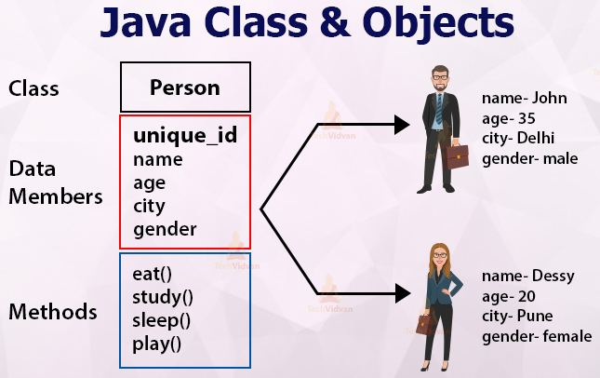
Java Classes/Objects
Object Oriented Techniques using Java Unit No: II

Slide 10
General Form of a Class
class classname
{
type instance-variable1;
type instance-variableN;
type methodname1(parameter-list)
{
// body of method
}
type methodnameN(parameter-list)
{
// body of method
}
}
class Box
{
double width;
double height;
double depth;
void volume()
{
System.out.print("Volume is ");
System.out.println(width * height * depth);
}
}
Object Oriented Techniques using Java Unit No: II

Slide 11
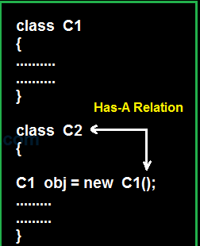
Object Creation
To actually create a Box object, you will use a statement like the following:
Box mybox = new Box();
Mybox is consider as Instance/object of class Type Box
Object Oriented Techniques using Java Unit No: II

Slide 12
Constructor
Constructor in java is a special type of method that is used to initialize the object.
Java constructor is invoked at the time of object creation.
Rules for creating java constructor:
1.Constructor name must be same as its class name
2.Constructor must have no explicit return type
3. Construct can’t be abstract, static, final or synchronized.
Object Oriented Techniques using Java Unit No: II

Slide 13
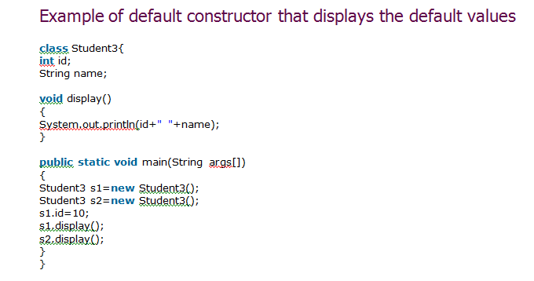
Types of constructor
1.default constructor
2.parameterized constructor
Object Oriented Techniques using Java Unit No: II

Slide 14
Parameterized Constructor
class Student4
{
int id;
String name;
Student4(int i,String n) //parameterized constructor(method)
{
id = i;
name = n;
}
void display() //simple menthod
{
System.out.println(id+" "+name);
}
public static void main(String args[])
{
Student4 s1 = new Student4(111,"Karan");
Student4 s2 = new Student4(222,"Aryan");
s1.display();
s2.display();
}
}
Object Oriented Techniques using Java Unit No: II

Slide 15
Constructor Overloading
Constructor overloading is a technique in Java in which a class can have any number of constructors that differ in parameter lists.
The compiler differentiates these constructors by taking into account the number of parameters in the list and their type.
Object Oriented Techniques using Java Unit No: II

Slide 16
Constructor Overloading
class Student5{
int id;
String name;
int age;
Student5(int i,String n){
id = i;
name = n;
}
Student5(int i,String n,int a){
id = i;
name = n;
age=a;
}
void display(){System.out.println(id+" "+name+" "+age);}
public static void main(String args[])
{
Student5 s1 = new Student5(111,"Karan");
Student5 s2 = new Student5(222,"Aryan",25);
s1.display();
s2.display();
}
}
Object Oriented Techniques using Java Unit No: II

Slide 17
few more points about constructors
Constructor can use any access specifier, they can be declared as private also.
Private constructors are possible in java but there scope is within the class only.
If you don’t define any constructor within the class, compiler will do it for you and it will create a no-arg (default) constructor for you.
this() and super() should be the first statement in the constructor code.
Object Oriented Techniques using Java Unit No: II

Slide 18
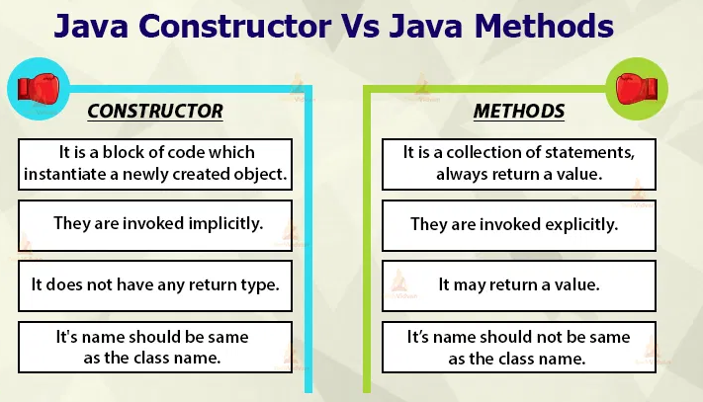
Constructor VS Methods
Object Oriented Techniques using Java Unit No: II

Slide 19
Abstract class
Abstraction is a process of hiding the implementation details and showing only functionality to the user.
A class which is declared with the abstract keyword is known as an abstract class in Java.
It can have abstract and non-abstract methods (method with the body).
Object Oriented Techniques using Java Unit No: II

Slide 20
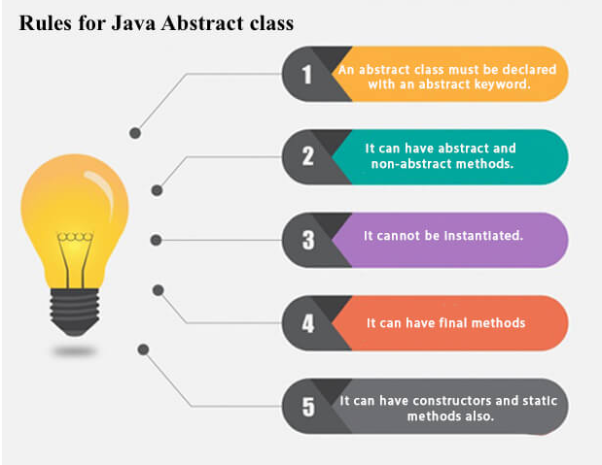
Abstract class
Object Oriented Techniques using Java Unit No: II

Slide 21
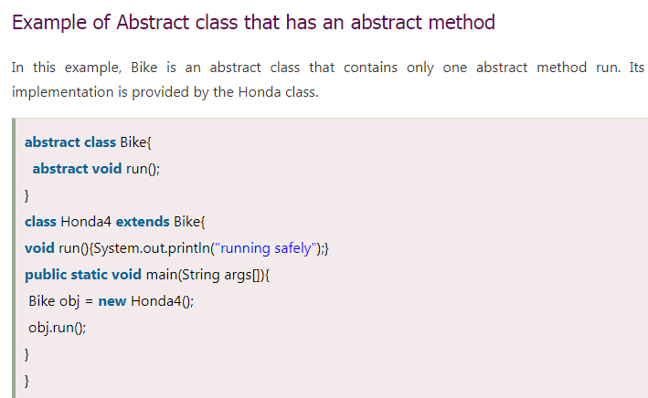
Cont…
Object Oriented Techniques using Java Unit No: II

Slide 22
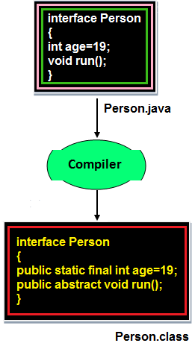
Interface
The interface is a mechanism to achieve fully abstraction in java and multiple inheritance in Java.
All the data members of interface are implicitly public static final.
Object Oriented Techniques using Java Unit No: II

Slide 23
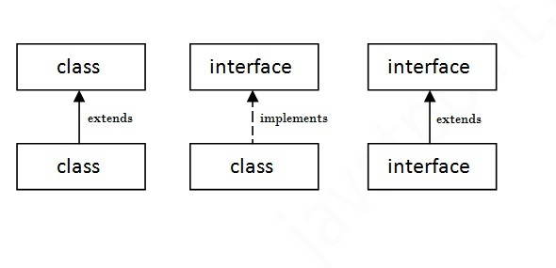
Interface
An interface in Java is a blueprint of a class. It has static constants and abstract methods.
The interface in Java is a mechanism to achieve abstraction. There can be only abstract methods in the Java interface, not method body. It is used to achieve abstraction and multiple inheritance in Java.
In other words, you can say that interfaces can have abstract methods and variables. It cannot have a method body.
Java Interface also represents the IS-A relationship.
Object Oriented Techniques using Java Unit No: II

Slide 24
Interface Example
interface hello
{
void print();
}
class Hi implements hello{
public void print()
{
System.out.println("Hello");
}
public static void main(String args[]){
Hi obj = new Hi();
obj.print();
}
}
Object Oriented Techniques using Java Unit No: II

Slide 25
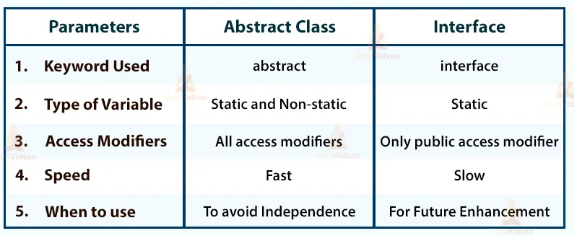
Abstract class vs Interface
Object Oriented Techniques using Java Unit No: II

Slide 26
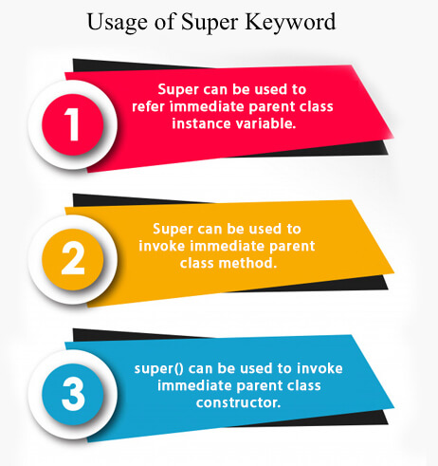
Super()
Super keyword in java is a reference variable that is used to refer parent class object.
Object Oriented Techniques using Java Unit No: II

Slide 27
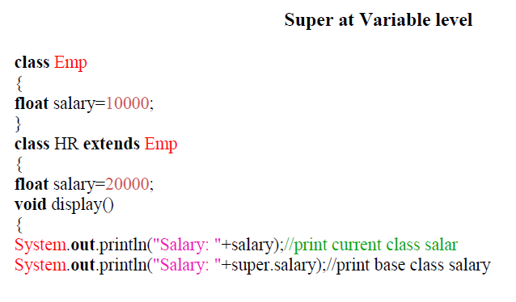
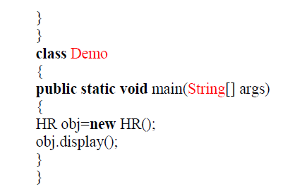
Cont..
Object Oriented Techniques using Java Unit No: II

Slide 28
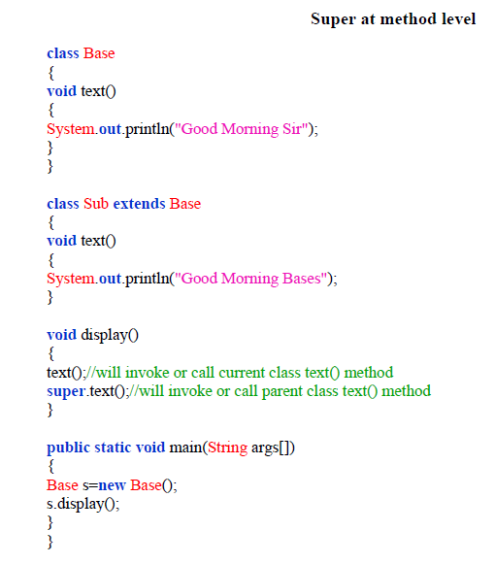
Cont..
Object Oriented Techniques using Java Unit No: II

Slide 29
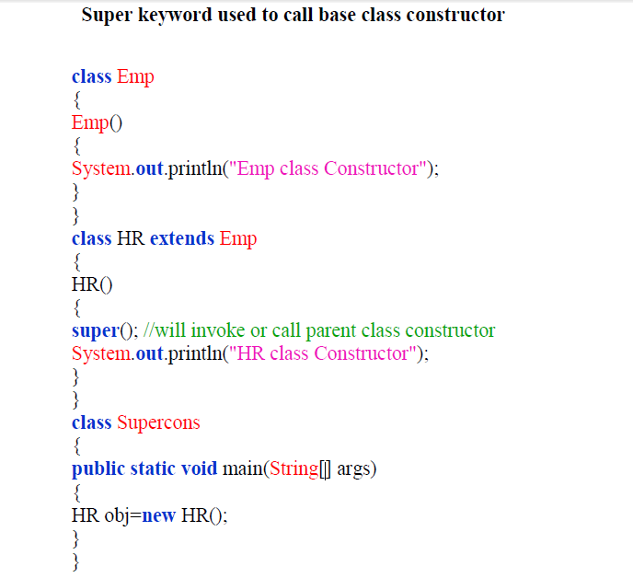
Cont..
Object Oriented Techniques using Java Unit No: II

Slide 30
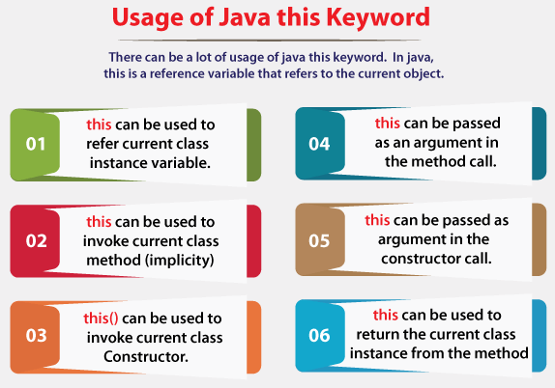
This
This is a reference variable that refers to the current object.
Note: If any variable is preceded by "this" JVM treated that variable as class variable.
Object Oriented Techniques using Java Unit No: II

Slide 31
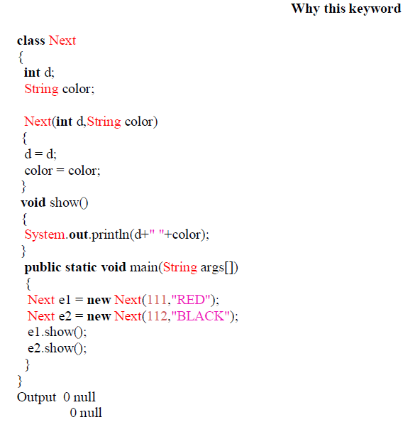
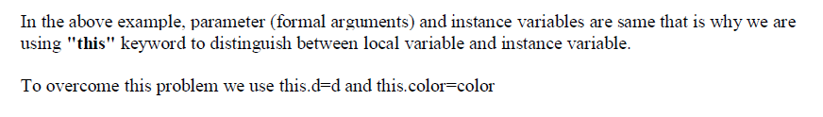
Cont..
Object Oriented Techniques using Java Unit No: II

Slide 32
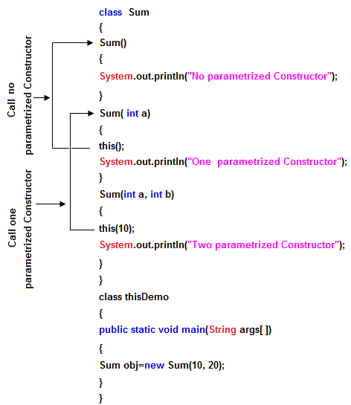
this() always should be the first statement of the constructor. One constructor can call only other single constructor at a time by using this().
Object Oriented Techniques using Java Unit No: II

Slide 33
this() and super()
super keyword is used to access methods of the parent class while this is used to access methods of the current class.
this is a reserved keyword in java i.e, we can’t use it as an identifier.
this()
this is used to refer current-class’s instance as well as static members.
this can be used in various contexts as given below:
to refer instance variable of current class
to invoke or initiate current class constructor
can be passed as an argument in the method call
can be passed as argument in the constructor call
can be used to return the current class instance
Object Oriented Techniques using Java Unit No: II

Slide 34
this() and super()
super()
super is a reserved keyword in java i.e, we can’t use it as an identifier.
super is used to refer super-class’s instance as well as static members.
super is also used to invoke super-class’s method or constructor.
Object Oriented Techniques using Java Unit No: II

Slide 35
Sr. No. | Key | this | super
1 | Represent and Reference | this keyword mainly represents the current instance of a class. | On other hand super keyword represents the current instance of a parent class.
2 | Interaction with class constructor | this keyword used to call default constructor of the same class. | super keyword used to call default constructor of the parent class.
3 | Method accessibility | this keyword used to access methods of the current class as it has reference of current class. | One can access the method of parent class with the help of super keyword.
4 | Static context | this keyword can be referred from static context i.e can be invoked from static instance. For instance we can write System.out.println(this.x) which will print value of x without any compilation or runtime error. | On other hand super keyword can't be referred from static context i.e can't be invoked from static instance. For instance we cannot write System.out.println(super.x) this will leads to compile time error.
Object Oriented Techniques using Java Unit No: II

Slide 36

Garbage Collection in Java
In C/C++, programmer is responsible for both creation and destruction of objects.
But in Java, the programmer need not to care for all those objects which are no longer in use. Garbage collector destroys these objects.
Object Oriented Techniques using Java Unit No: II

Slide 37
Finalization
Just before destroying an object, Garbage Collector calls finalize() method on the object to perform cleanup activities.
Based on our requirement, we can override finalize() method for perform our cleanup activities like closing connection from database.
Object Oriented Techniques using Java Unit No: II

Slide 38
public class JavafinalizeExample1 {
public static void main(String[] args)
{
JavafinalizeExample1 obj = new JavafinalizeExample1();
System.out.println(obj.hashCode());
obj = null;
// calling garbage collector
System.gc();
System.out.println("end of garbage collection");
}
@Override
protected void finalize()
{
System.out.println("finalize method called");
}
}
Object Oriented Techniques using Java Unit No: II

Slide 39
output
2018699554
end of garbage collection
finalize method called
Object Oriented Techniques using Java Unit No: II

Slide 40
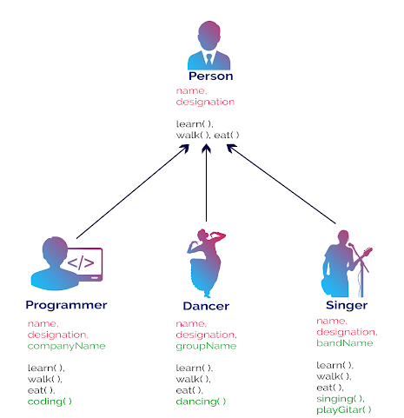
Inheritance
Inheritance in java is a mechanism in which one object acquires all the properties and behaviors of parent object.
Object Oriented Techniques using Java Unit No: II

Slide 41
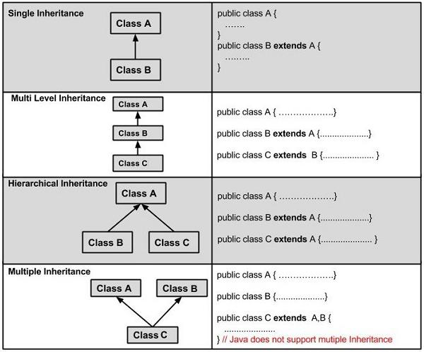
Types of Inheritance
Object Oriented Techniques using Java Unit No: II

Slide 42
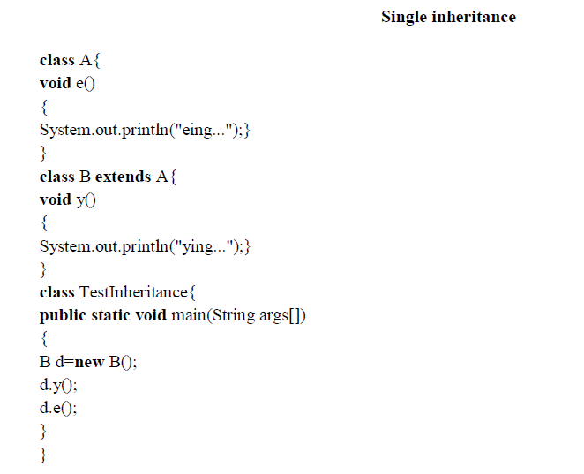
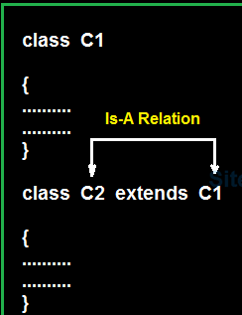
Cont..
Object Oriented Techniques using Java Unit No: II

Slide 43
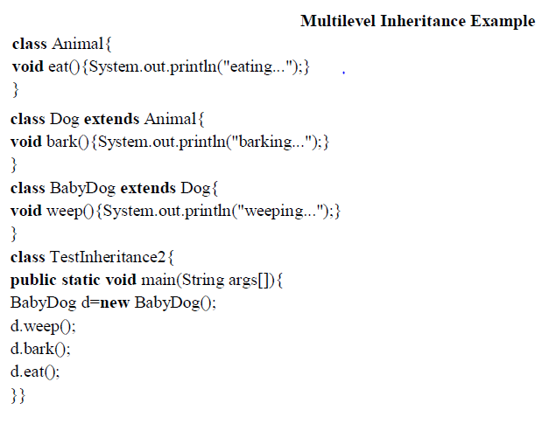
Cont..
Object Oriented Techniques using Java Unit No: II

Slide 44
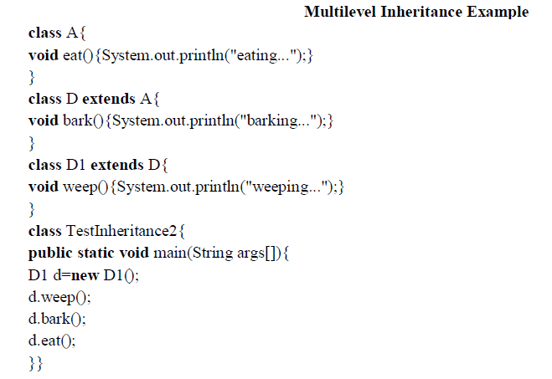
Cont..
Object Oriented Techniques using Java Unit No: II

Slide 45
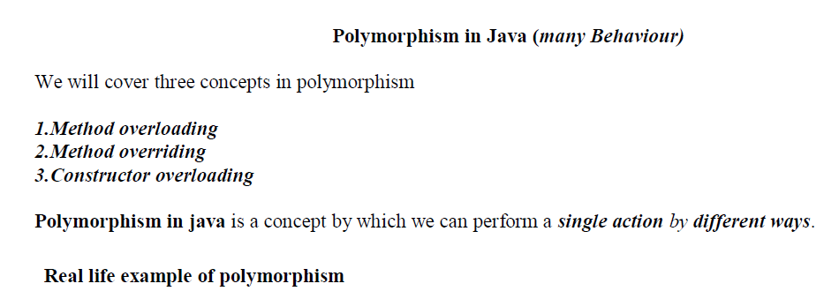
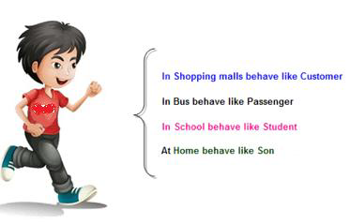
Polymorphism
Object Oriented Techniques using Java Unit No: II

Slide 46
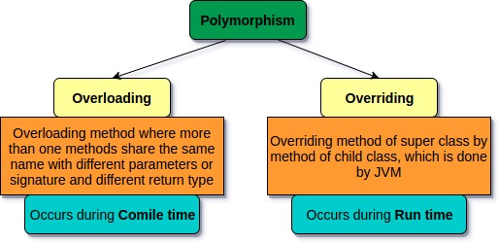
Types of Polymorphism
Static or Compile time polymorphism
Dynamic or Runtime polymorphism (Dynamic Binding)
Object Oriented Techniques using Java Unit No: II

Slide 47
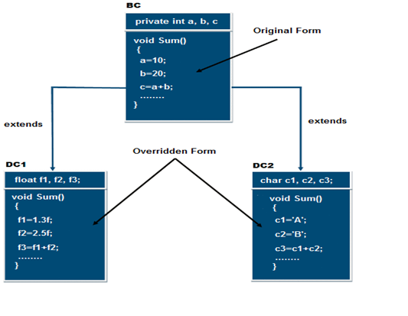
Cont..
Object Oriented Techniques using Java Unit No: II

Slide 48
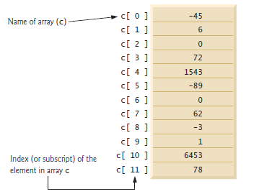
Array
An array is a group of variables (called elements or components) containing values that all have the same type.
Arrays are objects, so they’re considered reference types.
Object Oriented Techniques using Java Unit No: II

Slide 49
Declaration/Defining Array
1.Declare an integer array variable
int[] primes;
int []primes;
int primes[] ;
Note: At the time of declaration size is not required other wise we will get CTE
2.Defining an Array/Array Creation
Every array in java is an object only. Hence we can create array by using new operator
primes = new int[10]; // Define an array of 10 integers
Object Oriented Techniques using Java Unit No: II

Slide 50
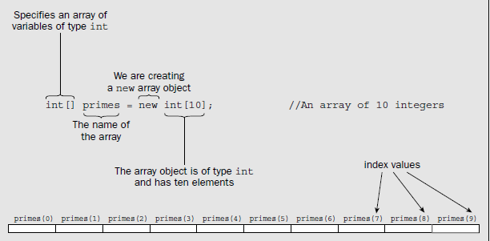
You can declare and create Array in single line
Object Oriented Techniques using Java Unit No: II

Slide 51
Justify array in java is object
Consider following code
class Test
{
psvm(String [] args)
{
int []x=new int[3]
s.o.p(x.getClass().getName());
}
}
For every array type corresponding classes are available and these classes are part of java language and not available to the programmer level
Object Oriented Techniques using Java Unit No: II

Slide 52
Cont..
Advantages
Code Optimization: It makes the code optimized, we can retrieve or sort the data efficiently.
Random access: We can get any data located at an index position.
Disadvantages
Size Limit: We can store only the fixed size of elements in the array. It doesn't grow its size at runtime. To solve this problem, collection framework is used in Java which grows automatically.
Object Oriented Techniques using Java Unit No: II

Slide 53
Types of Array in java
There are two types of array.
Single Dimensional Array
Multidimensional Array
Object Oriented Techniques using Java Unit No: II

Slide 54
Single Dimensional Array in Java
Syntax to Declare an Array in Java
dataType[] arr; (or)
dataType []arr; (or)
dataType arr[];
Instantiation of an Array in Java
arrayRefVar=new datatype[size];
Object Oriented Techniques using Java Unit No: II

Slide 55
/Java Program to illustrate how to declare, instantiate, initialize
//and traverse the Java array.
class Testarray{
public static void main(String args[]){
int a[]=new int[5];//declaration and instantiation
a[0]=10;//initialization
a[1]=20;
a[2]=70;
a[3]=40;
a[4]=50;
//int a[]={33,3,4,5};//declaration, instantiation and initialization
//traversing array
for(int i=0;i<a.length;i++)//length is the property of array
System.out.println(a[i]);
}}
Output
10 20 70 40 50
Object Oriented Techniques using Java Unit No: II

Slide 56
For-each Loop for Java Array
//Java Program to print the array elements using for-each loop
class Testarray1{
public static void main(String args[]){
int arr[]={33,3,4,5};
//printing array using for-each loop
for(int i:arr)
System.out.println(i);
}}
Object Oriented Techniques using Java Unit No: II

Slide 57
Multidimensional Array in Java
dataType[][] arrayRefVar; (or)
dataType [][]arrayRefVar; (or)
dataType arrayRefVar[][]; (or)
dataType []arrayRefVar[];
int[][] arr=new int[3][3];//3 row and 3 column
Object Oriented Techniques using Java Unit No: II

Slide 58
//Java Program to illustrate the use of multidimensional array
class Testarray3{
public static void main(String args[]){
//declaring and initializing 2D array
int arr[][]={{1,2,3},{2,4,5},{4,4,5}};
//printing 2D array
for(int i=0;i<3;i++){
for(int j=0;j<3;j++){
System.out.print(arr[i][j]+" ");
}
System.out.println();
}
}}
Output
1 2 3
2 4 5
4 4 5
Object Oriented Techniques using Java Unit No: II

Slide 59
Lambda Expressions in JAVA
It provides a clear and concise way to represent one method interface using an expression.
It is very useful in collection library.
It helps to iterate, filter and extract data from collection.
The Collection in Java is a framework that provides an architecture to store and manipulate the group of objects.
Java Collections can achieve all the operations that you perform on a data such as searching, sorting, insertion, manipulation, and deletion.
Java Collection means a single unit of objects. Java Collection framework provides many interfaces (Set, List, Queue, Deque) and classes (ArrayList
, Vector, LinkedList, PriorityQueue, HashSet, LinkedHashSet, TreeSet).
Object Oriented Techniques using Java Unit No: II

Slide 60
The Lambda expression is used to provide the implementation of an interface which has functional interface.
It saves a lot of code.
In case of lambda expression, we don't need to define the method again for providing the implementation. Here, we just write the implementation code.
Java lambda expression is treated as a function, so compiler does not create .class file.
Lambda expression provides implementation of functional interface.
An interface which has only one abstract method is called functional interface. Java provides an anotation @FunctionalInterface, which is used to declare an interface as functional interface.
Object Oriented Techniques using Java Unit No: II

Slide 61
Why use Lambda Expression
To provide the implementation of Functional interface.
Less coding.
Object Oriented Techniques using Java Unit No: II

Slide 62
Java Lambda Expression Syntax
(argument-list) -> {body}
Java lambda expression is consisted of three components.
1) Argument-list: It can be empty or non-empty as well.
2) Arrow-token: It is used to link arguments-list and body of expression.
3) Body: It contains expressions and statements for lambda expression.
Object Oriented Techniques using Java Unit No: II

Slide 63
@FunctionalInterface //It is optional
interface Drawable{
public void draw();
}
public class LambdaExpressionExample2 {
public static void main(String[] args) {
int width=10;
//with lambda
Drawable d2=()->{ //No parameter
System.out.println("Drawing "+width);
};
d2.draw();
}
}
Object Oriented Techniques using Java Unit No: II

Slide 64
interface Sayable{
public String say(String name);
}
public class LambdaExpressionExample4{
public static void main(String[] args) {
// Lambda expression with single parameter.
Sayable s1=(name)->{
return "Hello, "+name;
};
System.out.println(s1.say("Sonoo"));
// You can omit function parentheses
Sayable s2= name ->{
return "Hello, "+name;
};
System.out.println(s2.say("Sonoo"));
}
}
Object Oriented Techniques using Java Unit No: II

Slide 65
interface Addable{
int add(int a,int b);
}
public class LambdaExpressionExample5{
public static void main(String[] args) {
// Multiple parameters in lambda expression
Addable ad1=(a,b)->(a+b);
System.out.println(ad1.add(10,20));
// Multiple parameters with data type in lambda expression
Addable ad2=(int a,int b)->(a+b);
System.out.println(ad2.add(100,200));
}
}
Object Oriented Techniques using Java Unit No: II

